Slide 1

演算法設計與分析
台大資工系
呂學一

Slide 2

Outline
Depth-first search on graphs

Slide 3
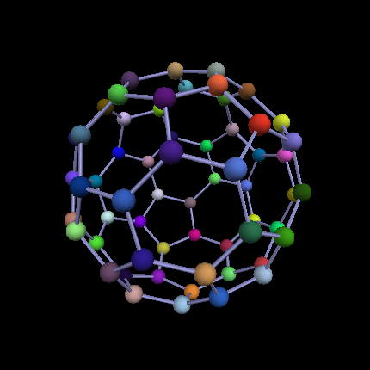
Graph
Adjacency of nodes

Slide 4
例如
1
3
2
6
5
4

Slide 5
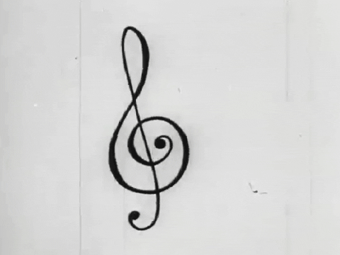
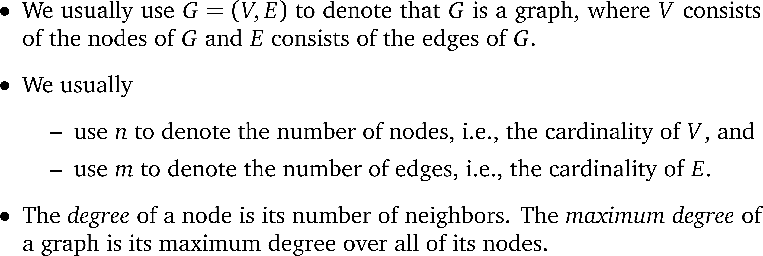
符號

Slide 6
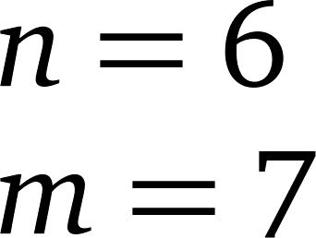
Examples
1
3
2
6
5
4

Slide 7
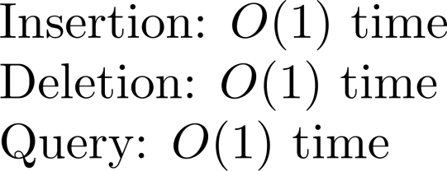
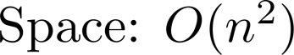
一種表示法: adjacency matrix
1
 | 1 | 2 | 3 | 4 | 5 | 6
1 |  | 1 | 1
2 | 1 |  |  | 1 | 1
3 | 1 |  |  | 1 |  | 1
4 |  | 1 | 1 |  |  | 1
5 |  | 1
6 |  |  | 1 | 1
3
2
6
5
4

Slide 8
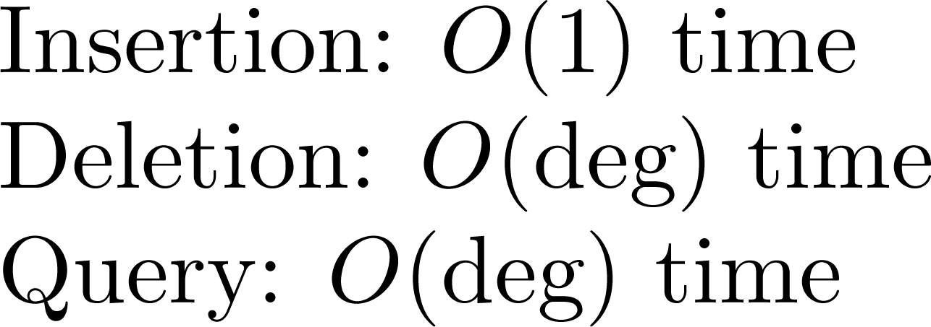
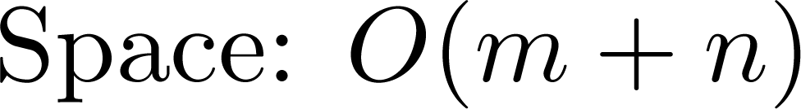
另一種表示法: adjacency list
1: 2, 3
2: 1, 4, 5
3: 1, 4, 6
4: 2, 3, 6
5: 2
6: 3, 4
1
3
2
6
5
4

Slide 9
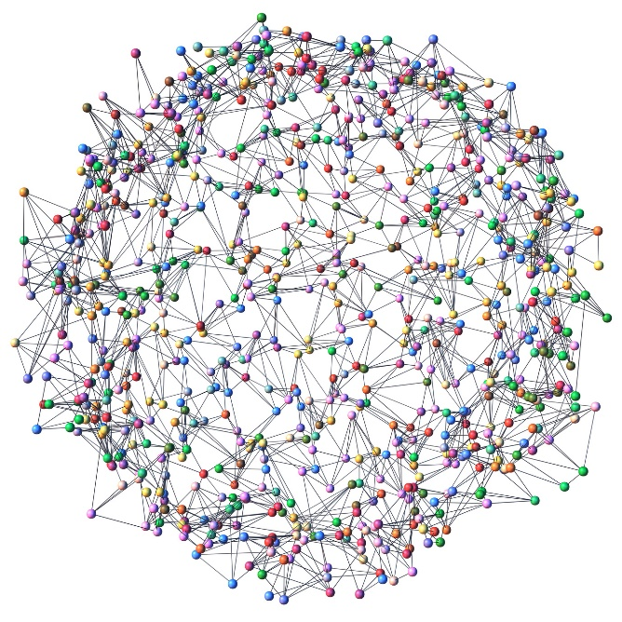
通常是後者
The input graph given to an algorithm is usually represented by an adjacency list.

Slide 10

三個問題
Connected components
Topological sort
Strongly connected components

Slide 11
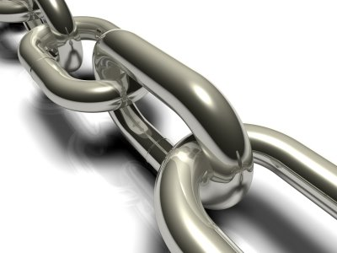
Problem 1
Connected components

Slide 12
Connected components

Slide 13
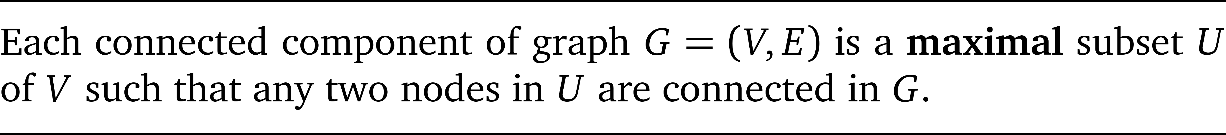
Definition

Slide 14
Connected subgraph

Slide 15
Observation
The connected components of a graph must be disjoint.
Why?

Slide 16
The problem
Input:
G = (V, E)
Output
The connected components of G

Slide 17

Question
What is the time complexity of this problem?

Slide 18
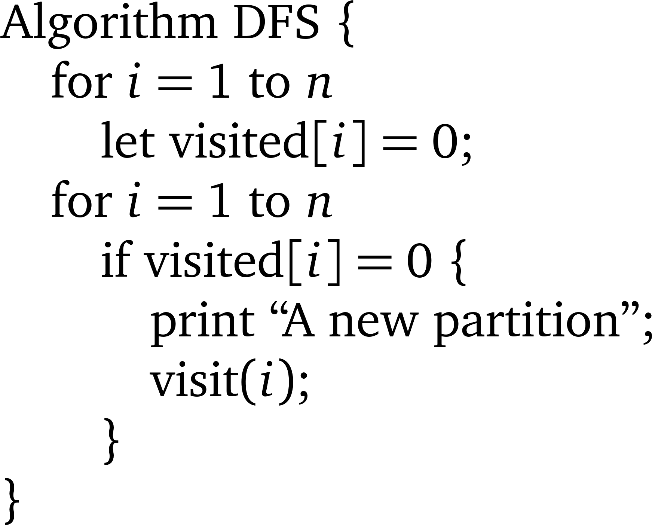
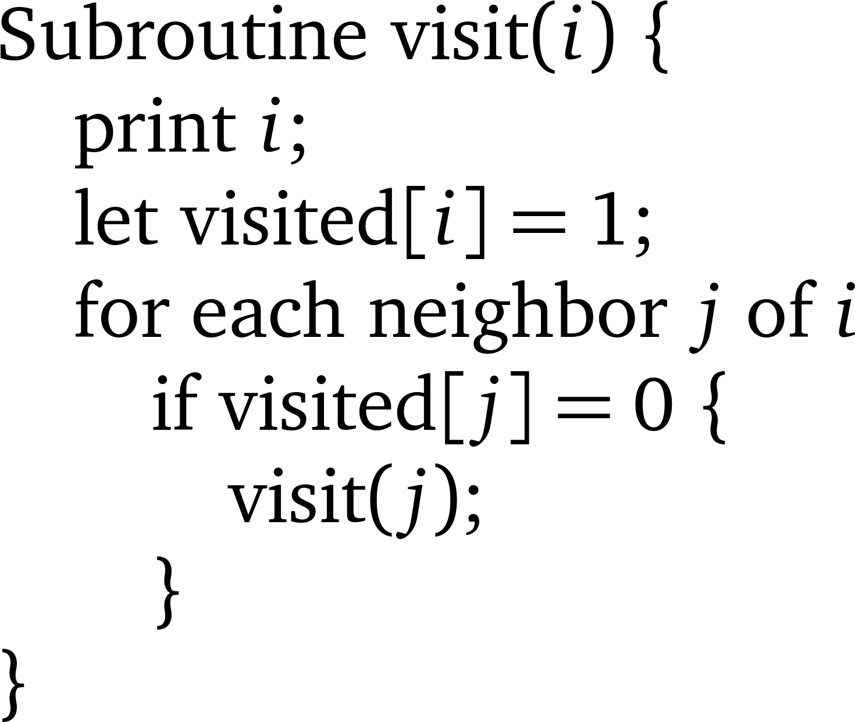

Depth-First Search

Slide 19
Connected components
1
7
5
2
8
9
6
3
4
10

Slide 20
Depth-First Search
Correctness?
O(m + n) time?

Slide 21
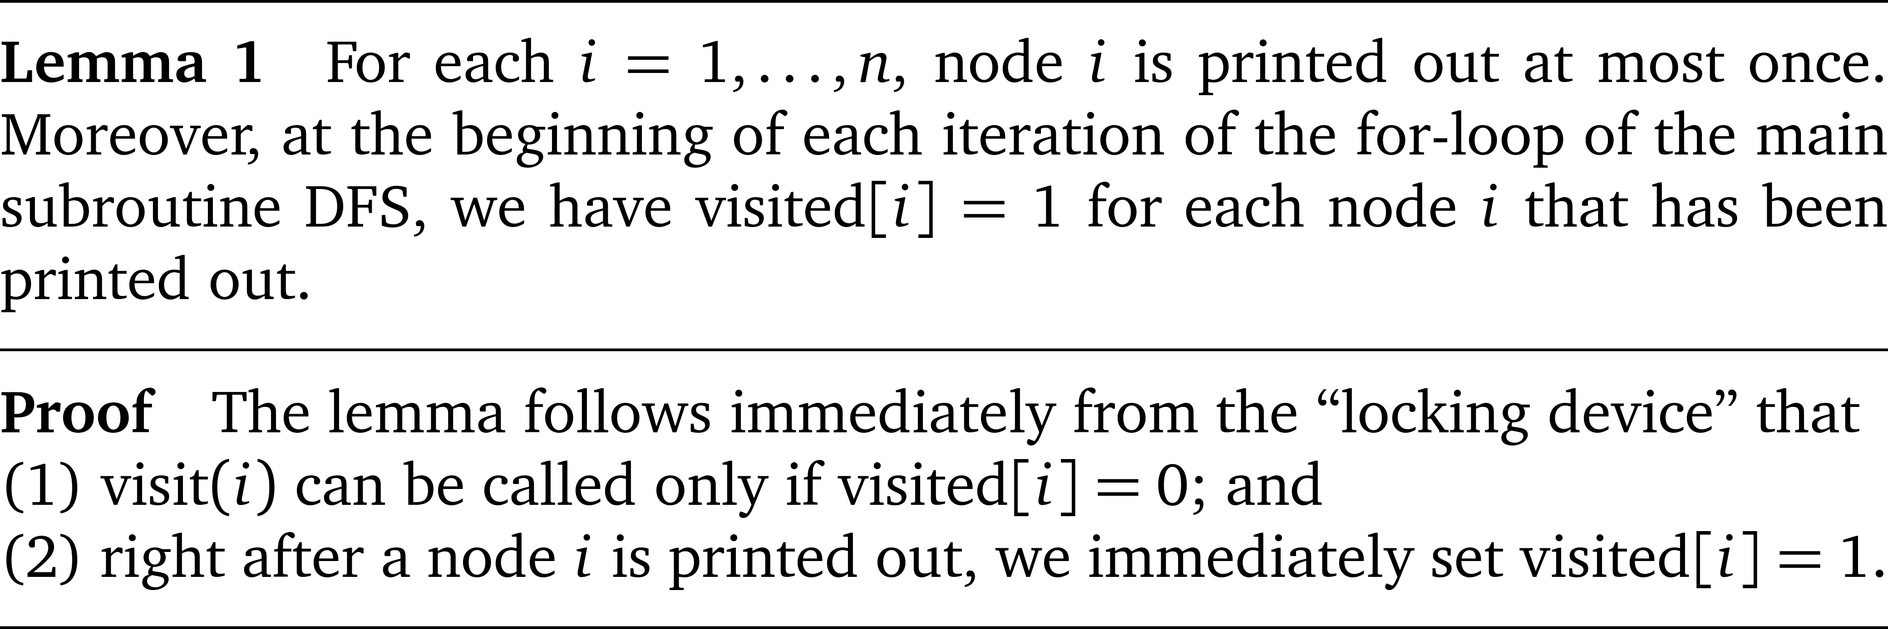
Lemma 1

Slide 22
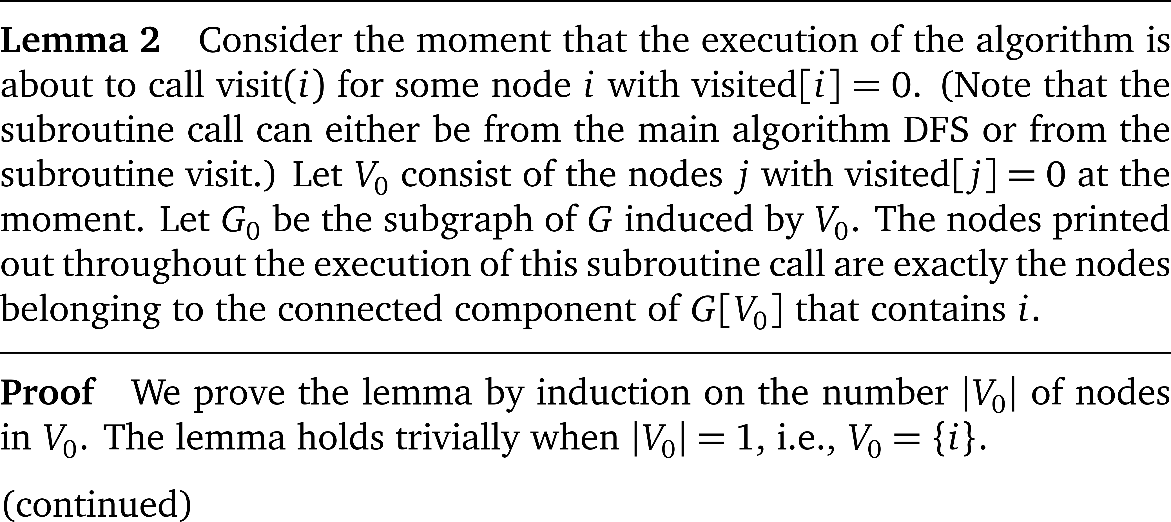
Lemma 2

Slide 23
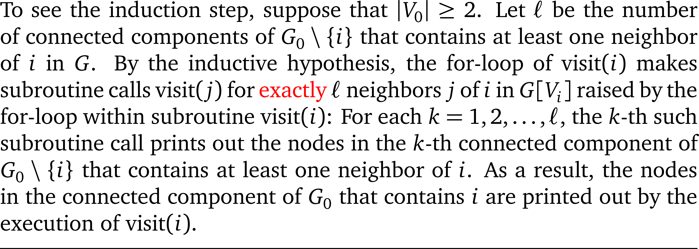
Lemma 2 (continued)

Slide 24
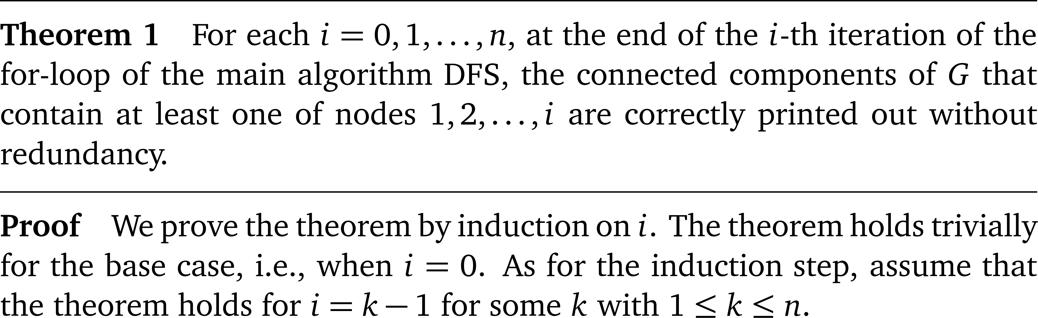
Theorem 1

Slide 25
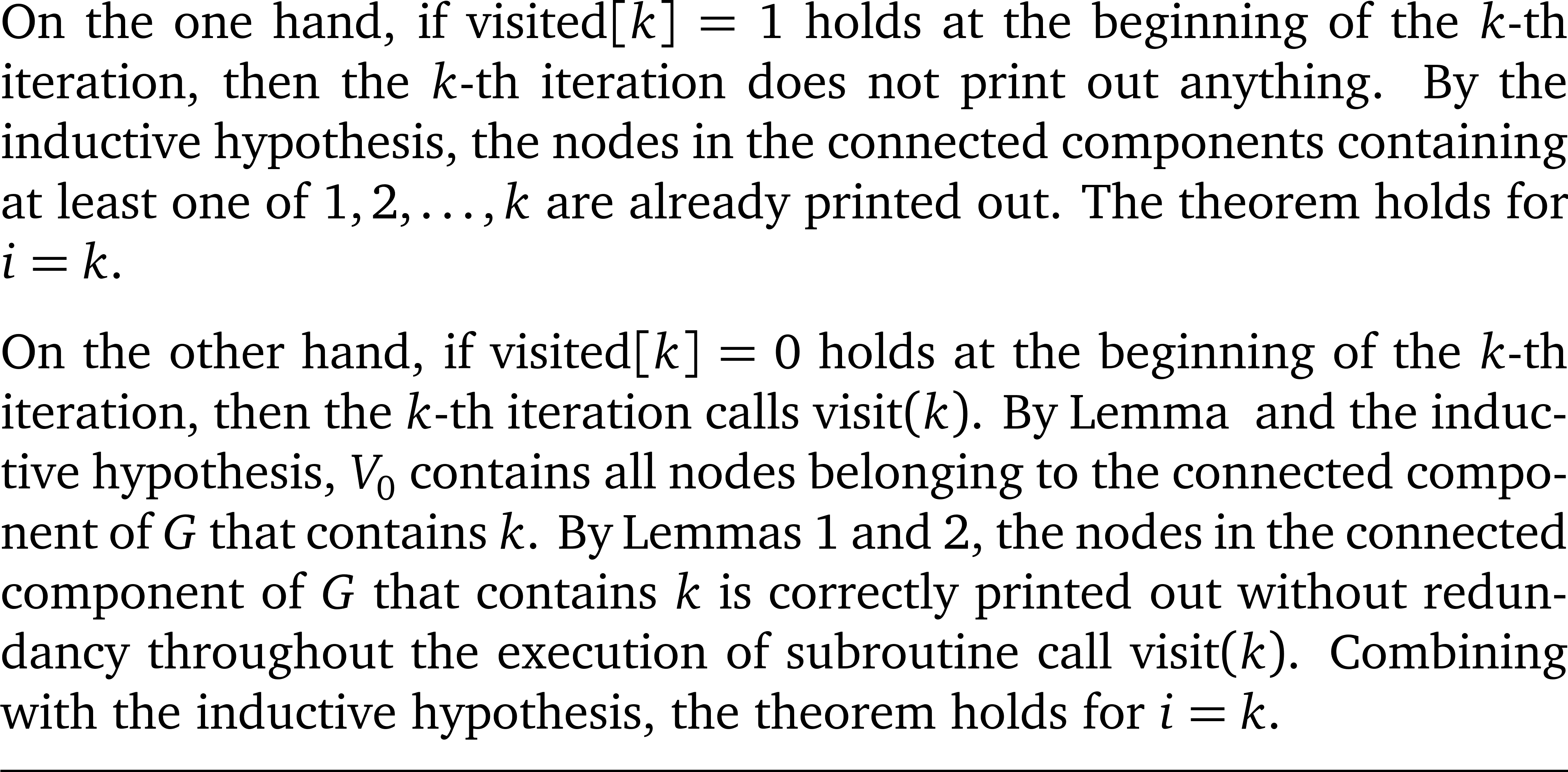
Theorem 1

Slide 26
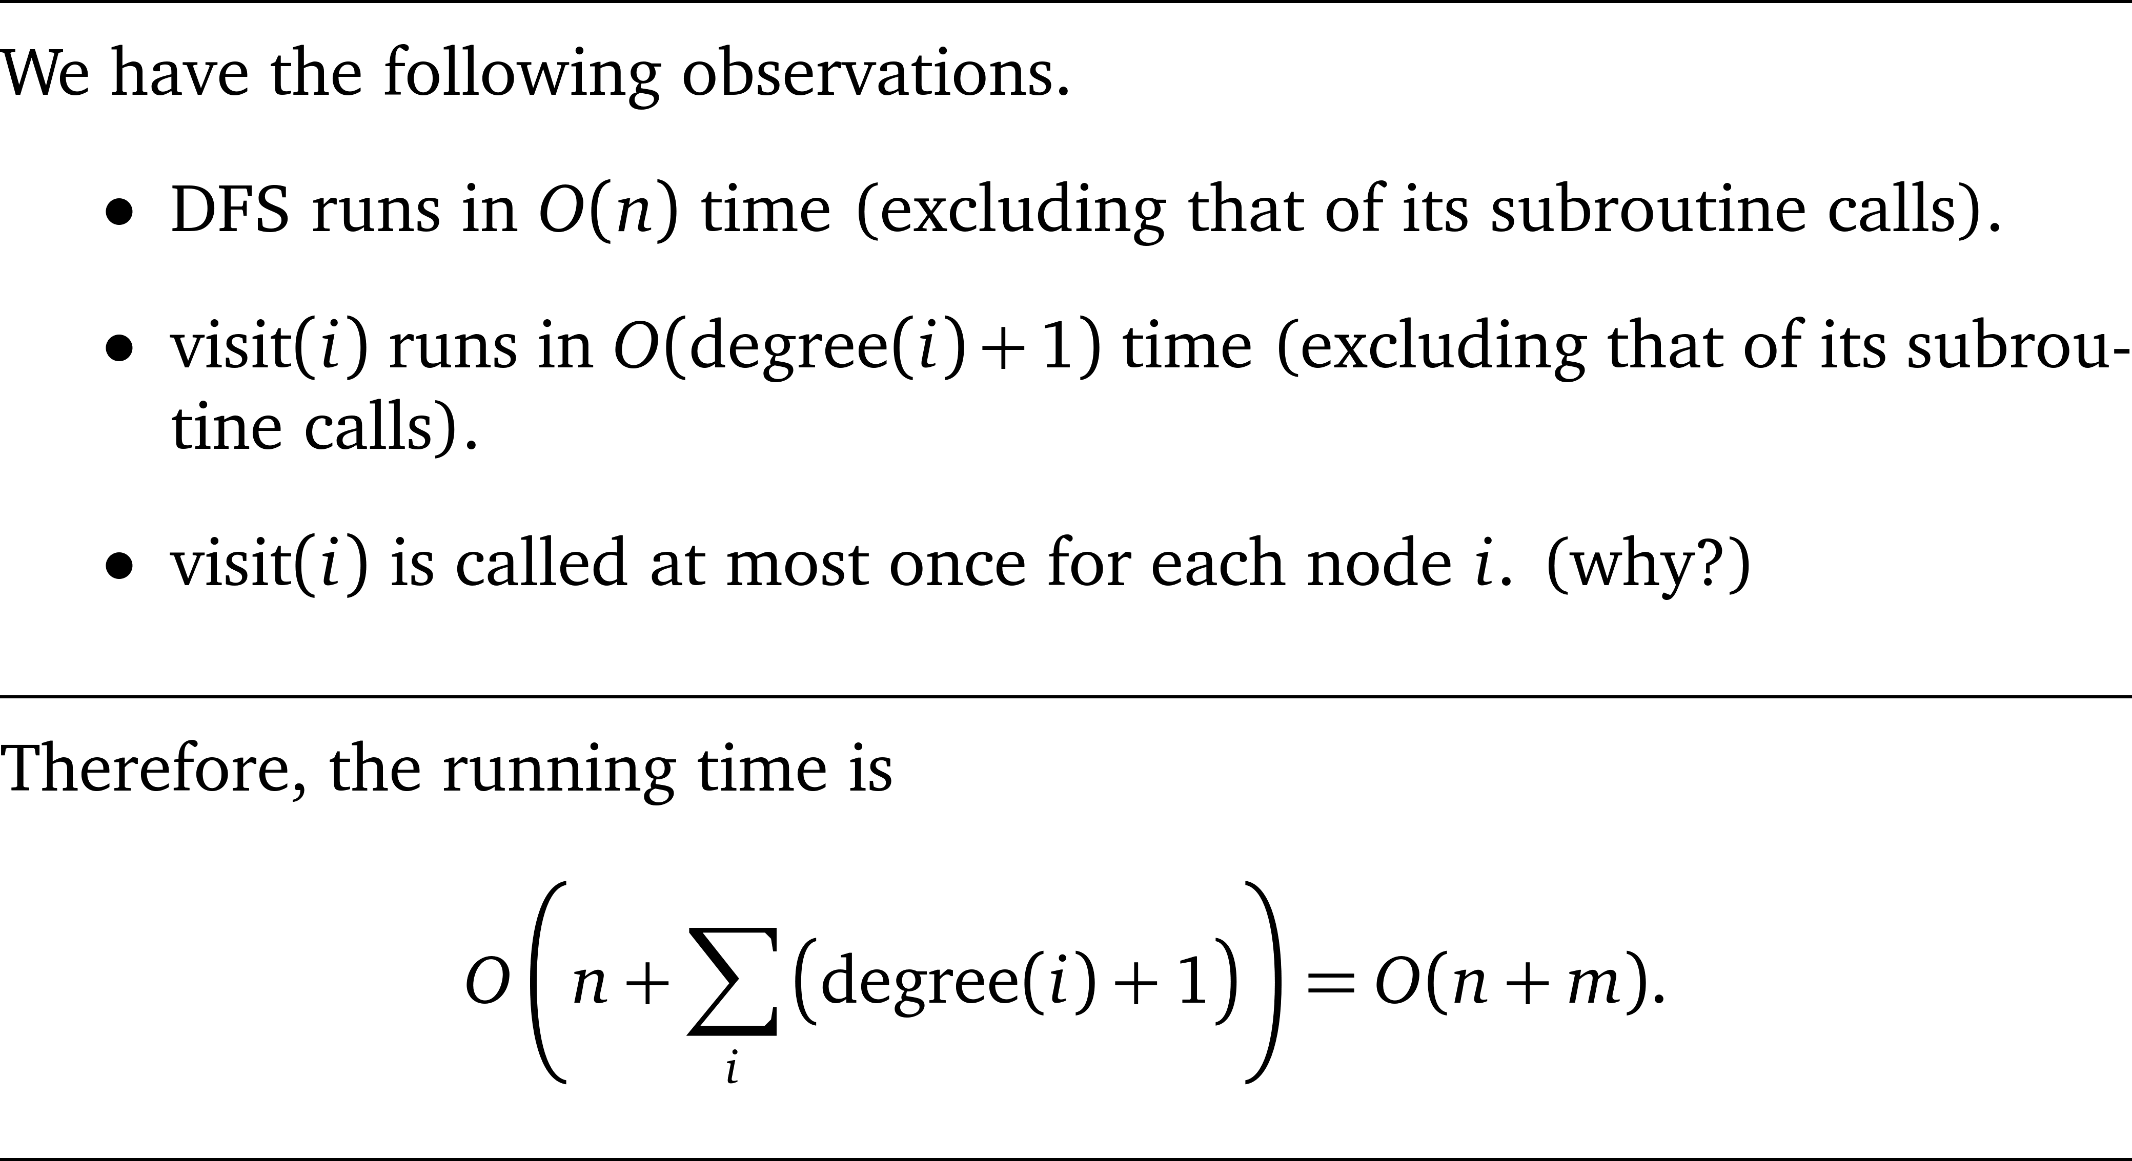
Linear time

Slide 27
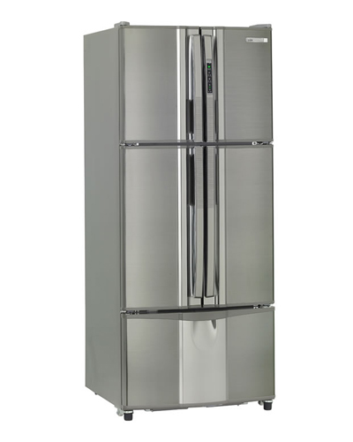
「連通元件」的複雜度

Slide 28
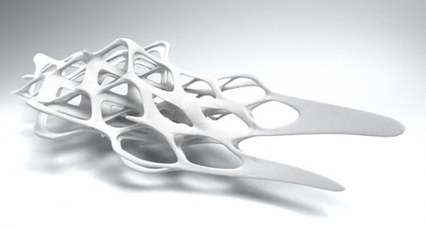
Problem 2
Topological sort

Slide 29
Directed graph
1
1
3
3
2
2
6
6
5
5
4
4

Slide 30
DAG
A directed acyclic graph (DAG) is a directed graph that does not contain any directed cycle.
1
3
2
6
5
4

Slide 31
The problem
Input:
A directed acyclic graph G = (V, E)
Output:
A linear order of V such that all edges of G going from lower-indexed nodes to higher-indexed nodes

Slide 32
Examples
f
a
b
c
e
d
a
d
b
e
a
f
b
c
e
d
f
c

Slide 33
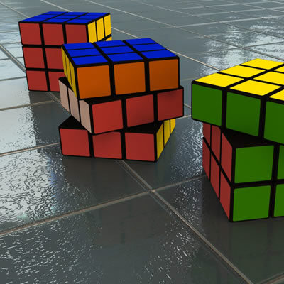
How to solve the problem?

Slide 34
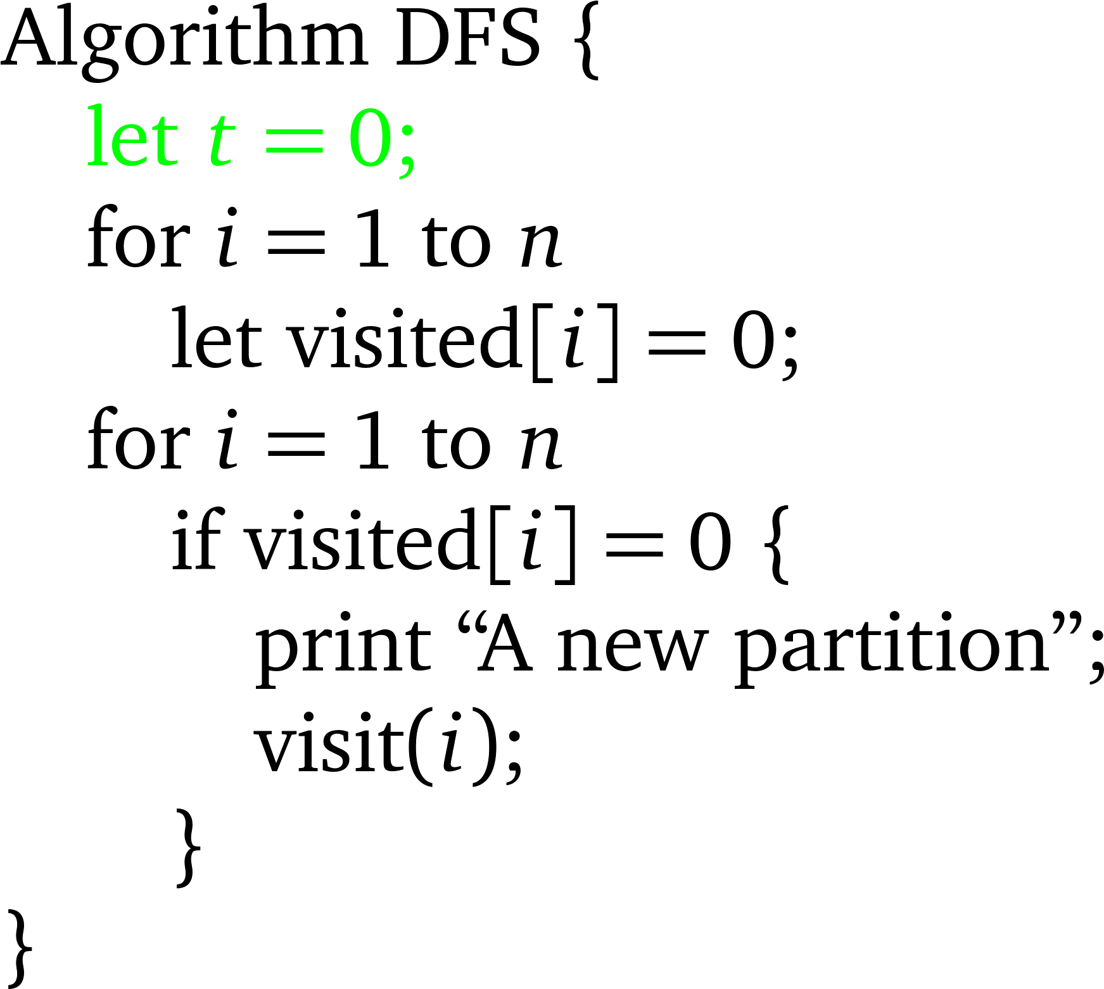
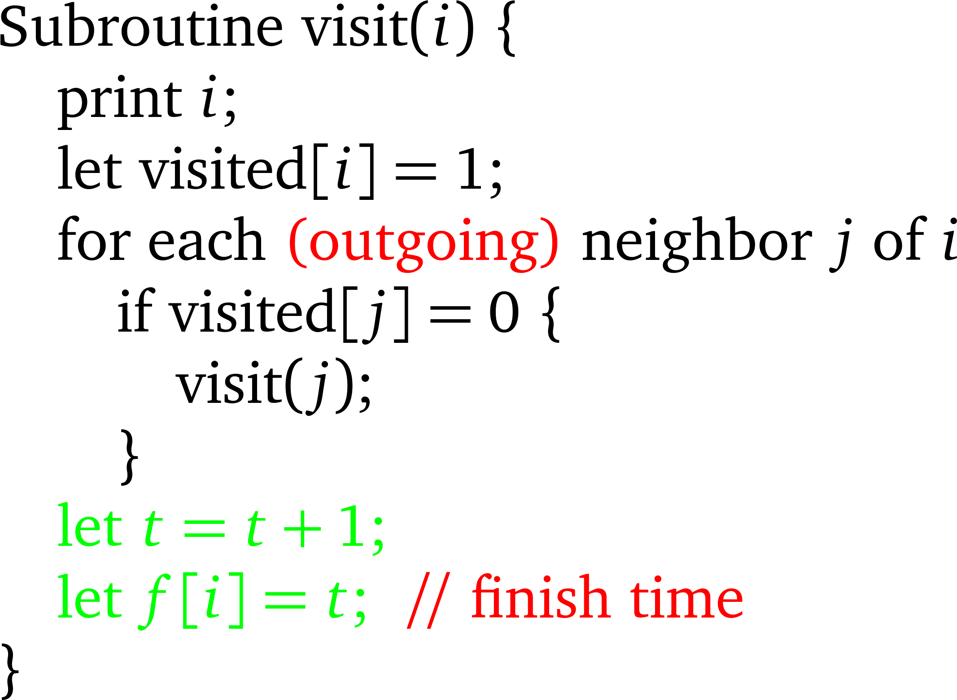
Depth-First Search

Slide 35

An algorithm
Run DFS on the input DAG G.
Output the nodes in decreasing order of their finish time.

Slide 36
Example A
5
f
a
b
c
e
d
a
1
d
4
b
2
e
f
c
3
6

Slide 37
Example B
6
a
1
d
4
b
2
e
a
f
b
c
e
d
f
c
3
5

Slide 38
正確性
Theorem: If (i,j) is a directed edge (from i to j) of G, then f[i] > f[j].
Proof. 考慮當我們的演算法正要「走過」(i, j)這個directed edge. 也就是visit(i)正要嘗試j這個鄰居是否已經被拜訪過的時刻。
Case 1: If visited[j] = 0, then OK. (why?)

Slide 39
Case 2: visited[j] = 1
If f[j] is already set, then OK. (why?)
If f[j] is not yet set, then
there is a directed path from j to i.
從任何一個點走出去再退回到該點的過程中所有點都一定已經有了f值。被visited而還沒有f值的點，一定形成一條directed path。
當下的這條directed path的終點是i，而j也在這條directed path 上。
Since (i,j) is a directed edge from i to j, it contradicts the fact that G is a directed acyclic graph.
所以這個情形不會發生。

Slide 40
Running time?

Slide 41
「拓樸排序」的複雜度

Slide 42
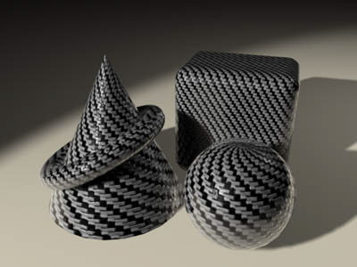
Problem 3
Strongly connected components

Slide 43
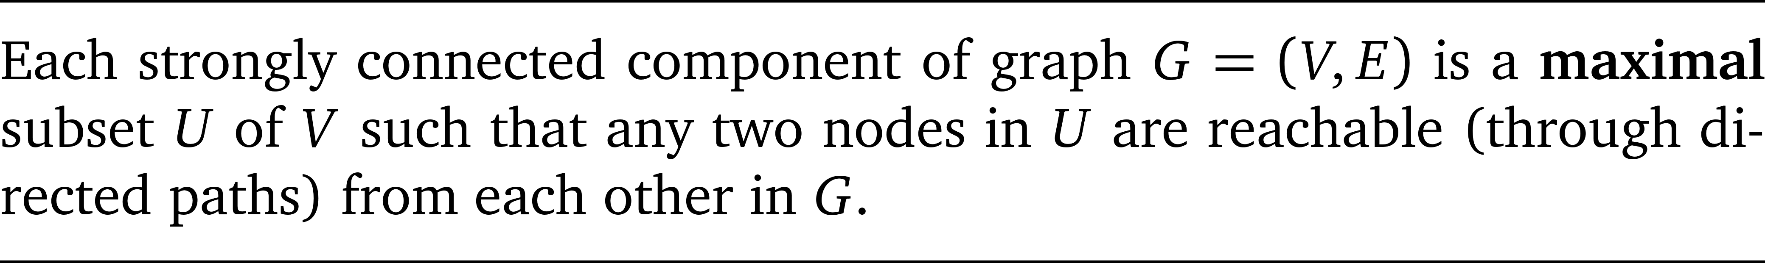
Strongly connected component

Slide 44
Example
1
7
4
2
8
5
6
3

Slide 45
Observation
The strongly connected components of a directed graph must be disjoint. (why?)

Slide 46
The problem
Input:
G = (V, E)
Output
The strongly connected components of G

Slide 47
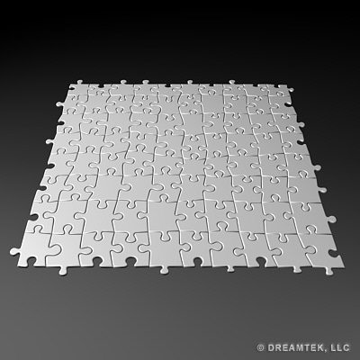
How to solve the problem?

Slide 48
A linear-time algorithm
Step 1: Run DFS on G to obtain the finish time f[v] of each node of G.
Step 2: Run DFS on the transpose of G where the nodes of G are processed in the decreasing order of their finish time.
The resulting partition of nodes by the second DFS forms the strongly connected components of G.

Slide 49
Transpose of a graph
1
1
4
4
2
2
5
5
6
6
3
3

Slide 50
Depth-First Search

Slide 51
Transpose of a graph
1
2
1
2
3
4
3
4
6
5
6
5

Slide 52
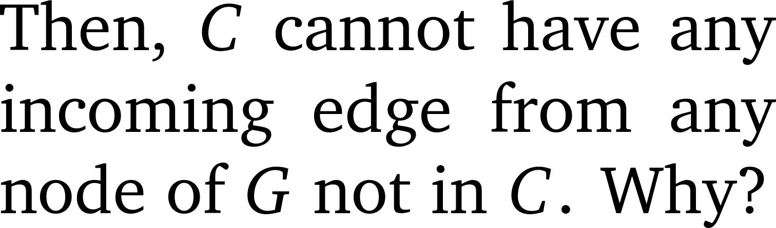
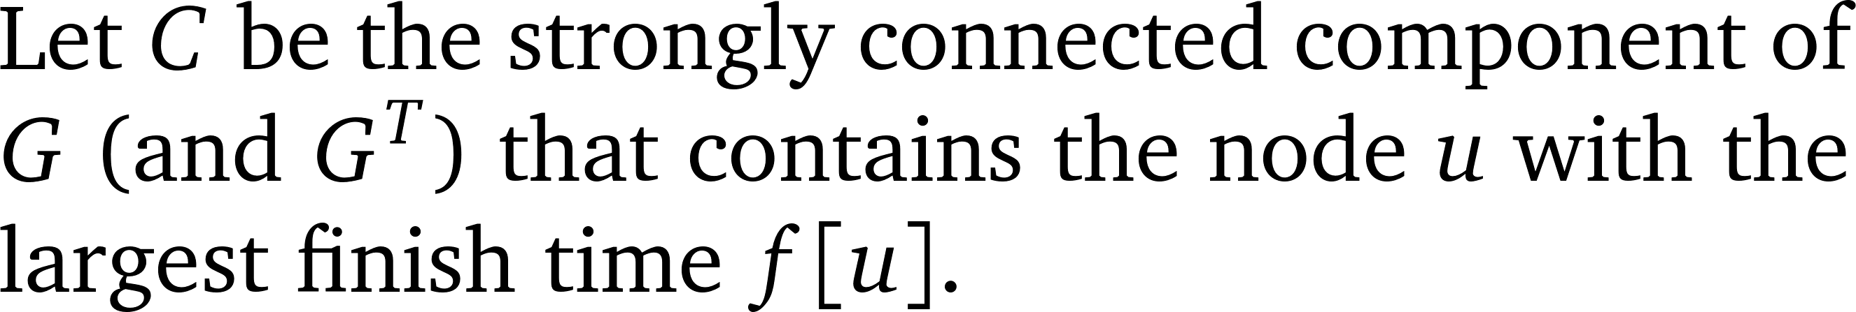
觀察一
C
G
u

Slide 53
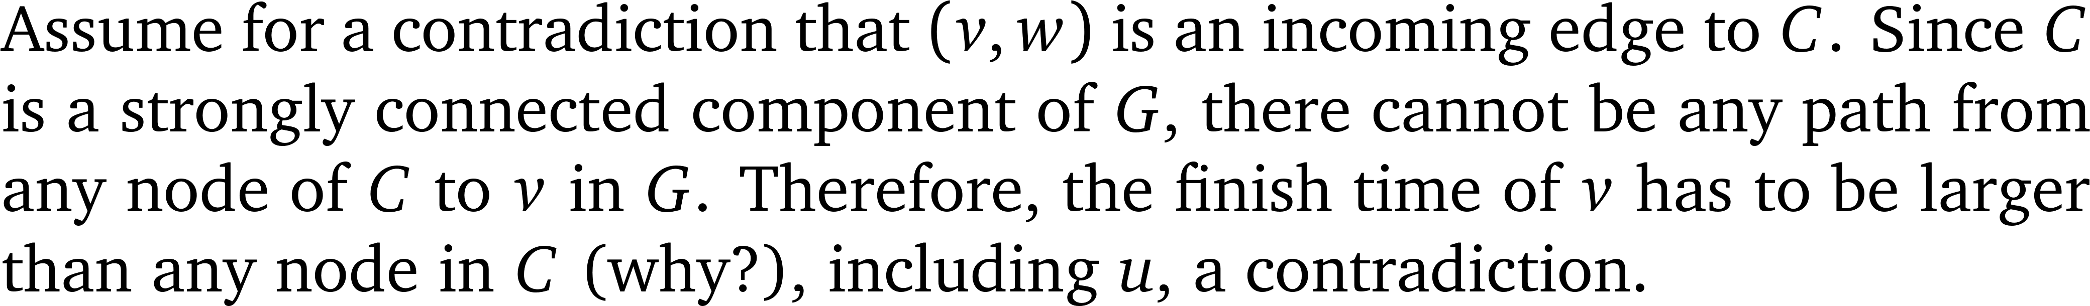
Reason
C
v
u
w

Slide 54

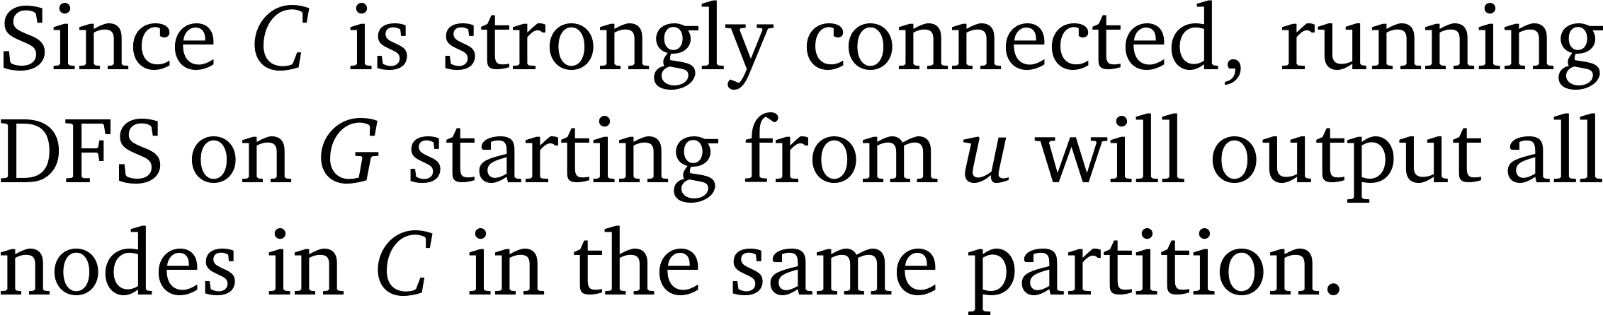
For the transpose of G, …
C
u

Slide 55
For example
1
2
3
4
6
5

Slide 56
Correctness
We then continue the process from the node u* whose finish time f[u*] is the largest excluding those in C.
By simple induction, one can prove that the algorithm is indeed correct.

Slide 57
For example
1
2
3
4
6
5

Slide 58
A linear-time algorithm
Step 1: Run DFS on G to obtain the finish time f[v] of each node of G.
Step 2: Run DFS on the transpose of G where the nodes of G are processed in the decreasing order of their finish time.
The resulting partition of nodes by the second DFS forms the strongly connected components of G.

Slide 59
「強連通元件」的難度

Slide 60

We are done!!
Depth-first search on graph
Connected components
Topological sort
Strongly connected components

